Slide 1
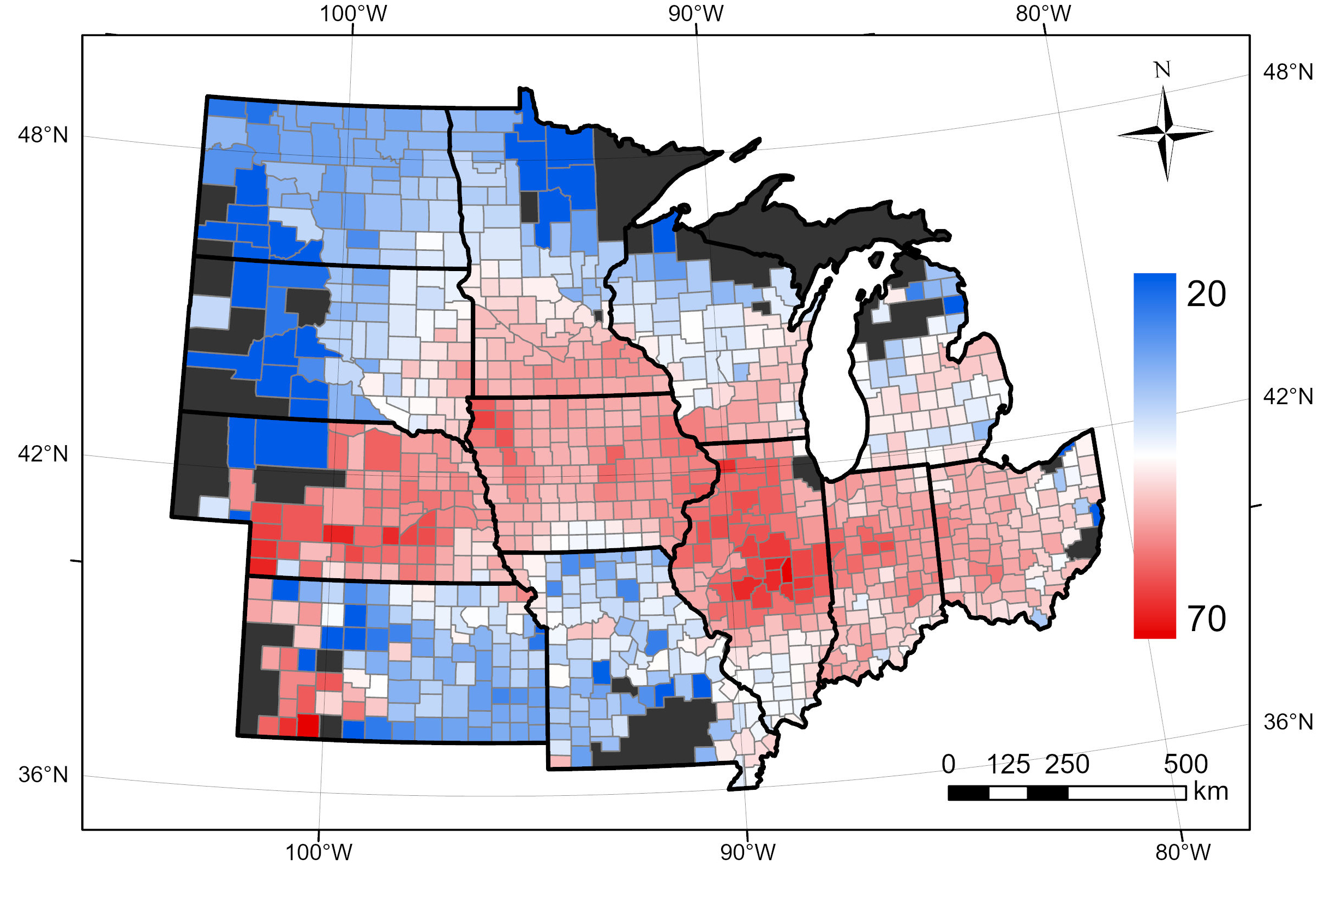
ND
MN
SD
WI
MI
IA
NE
IN
OH
IL
KS
MO

Slide 2
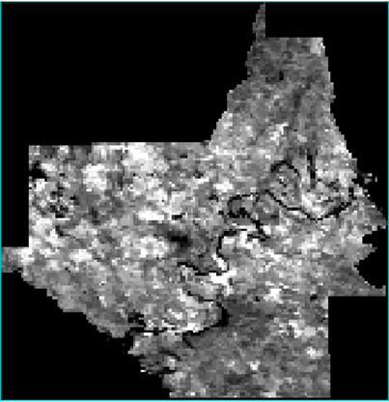
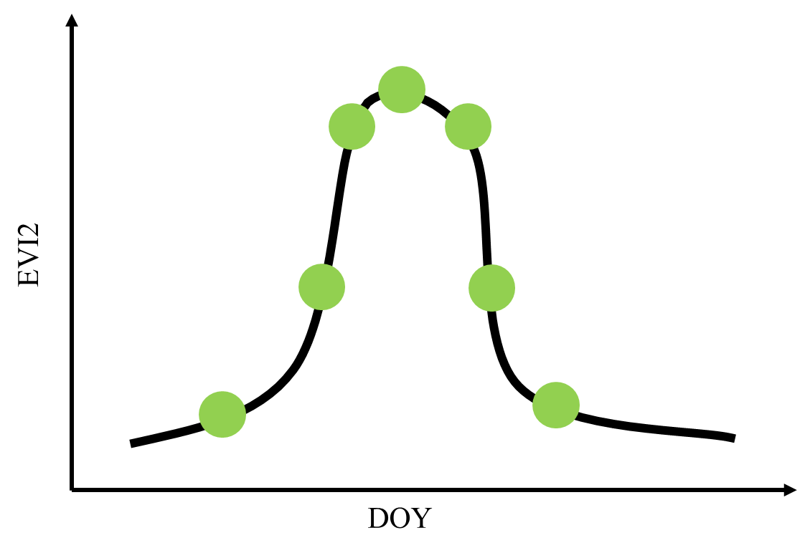
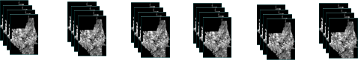
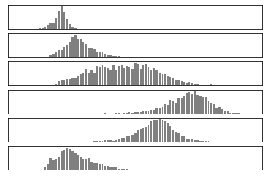

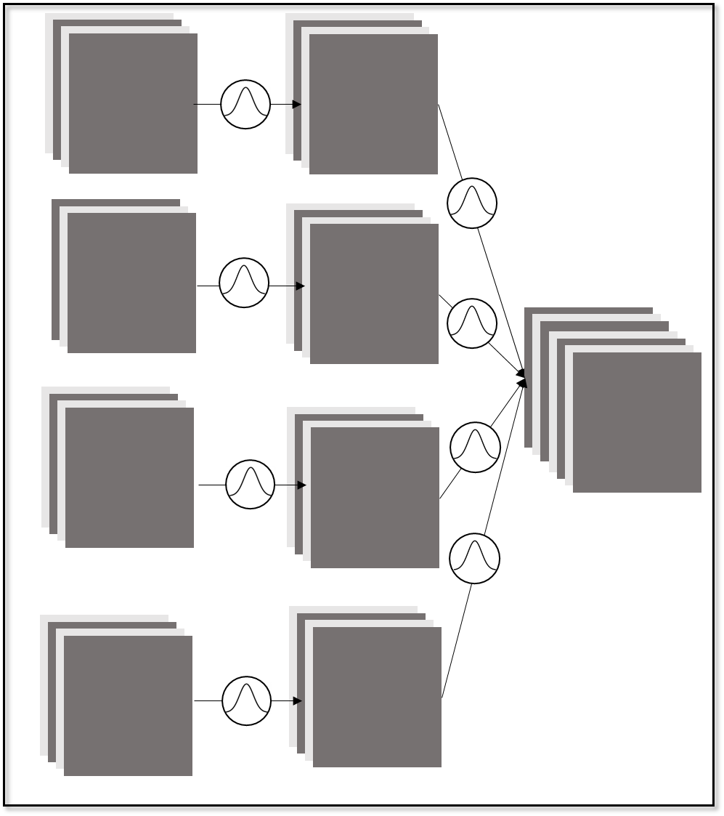
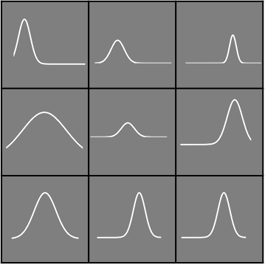
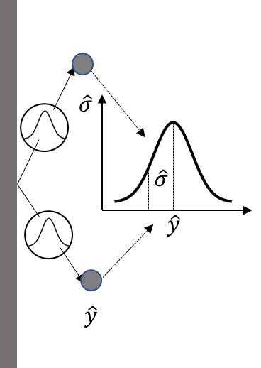
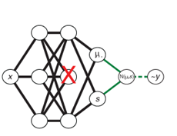
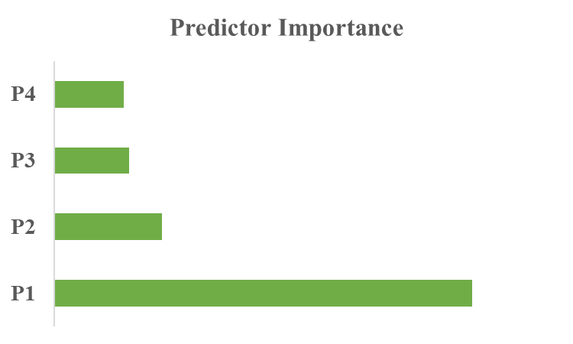
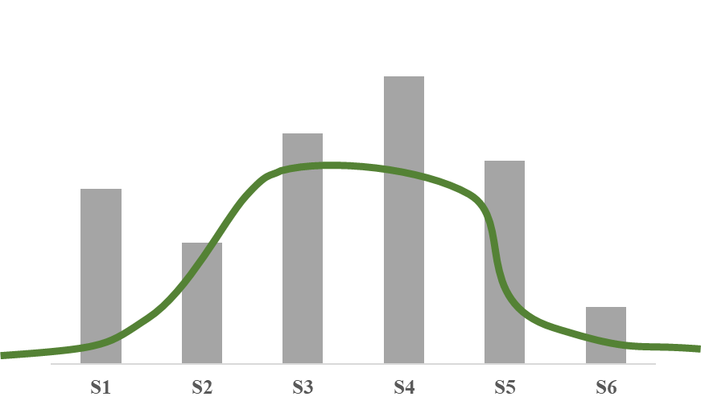
Phenology Imagery Construction
………………………………
……………………………
Remote sensing
Meteorological data
Soil
Phenologydate
Temporal aggregation
Spatial aggregation
Phenology Imagery
Multi-stream Bayesian-CNN
Bayesian distribution
Multi-stream PB-CNN
Parallel stream
Feature and Uncertainty Analysis
Feature importance
Yield estimation
Yield uncertainty
Predictor importance
Phenology importance
Aleatoric uncertainty
Epistemic uncertainty

Slide 4
Peak
Maturity
Senescence
EVI2
Max
MidGreenup
MidGreendown
Mean
Min
Greenup
Dormancy
Cumulative
DOY

Slide 5
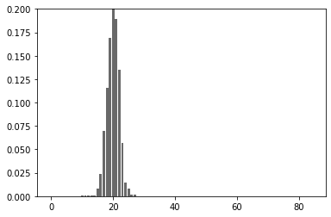
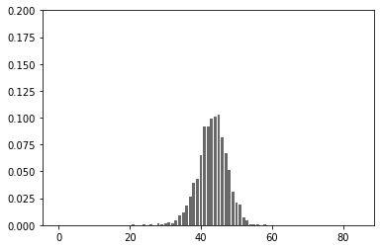
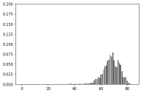
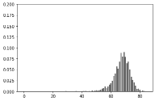
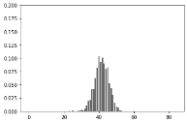

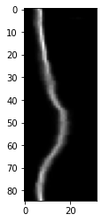
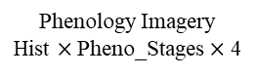
EVI2 Time Series
………………………………
……………………………
S3
S4
S5
S1
S2
EVI2
S6
DOY
Temporal aggregation
Mean, Min, Max, Cumulative aggregations
S1
S2
S3
S4
S5
S6
Histogram transformation
Spatial aggregation
Phenology Imagery
Hist $×$ Pheno_Stages $×$ 4

Slide 6
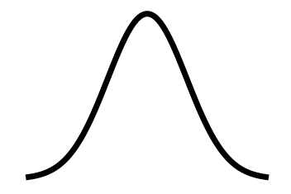
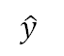
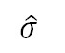
Part I
EVI2 11*6*4
CONV Block 1
Part II
$$\hat{σ}$$
Heat-related 11*6*4
CONV Block 2
$$\hat{σ}$$
$$\hat{y}$$
Concatenation layer
CONV
Block 5
CONV Block 6
Water-related 11*6*9
$$\hat{y}$$
CONV Block 3
FC layer
Soil 11*6*30
CONV Block 4

Slide 7
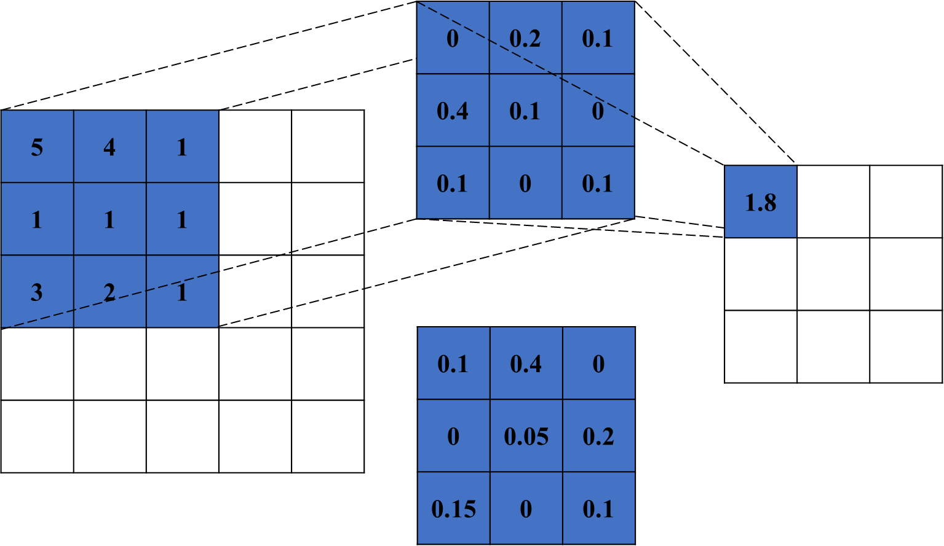
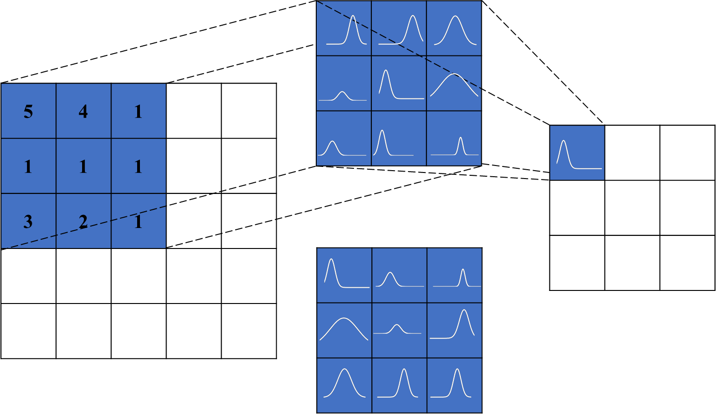

Slide 8
0 | 0.2 | 0.1
0.4 | 0.1 | 0
0.1 | 0 | 0.1
5 | 4 | 1
1 | 1 | 1
3 | 2 | 1
1.8
0.1 | 0.4 | 0
0 | 0.05 | 0.2
0.15 | 0 | 0.1

Slide 9
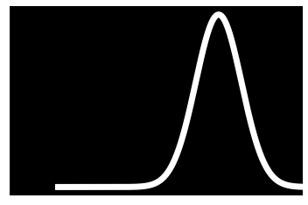
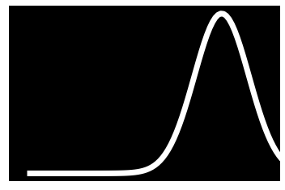
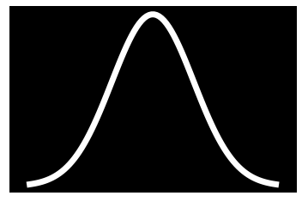

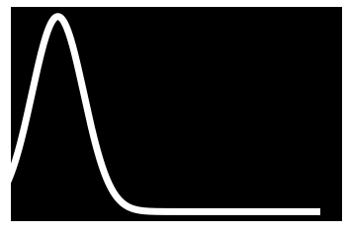
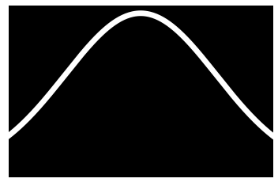


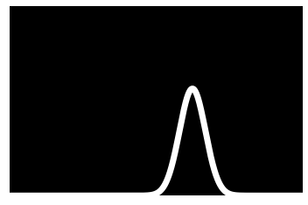
5 | 4 | 1
1 | 1 | 1
3 | 2 | 1

Slide 10
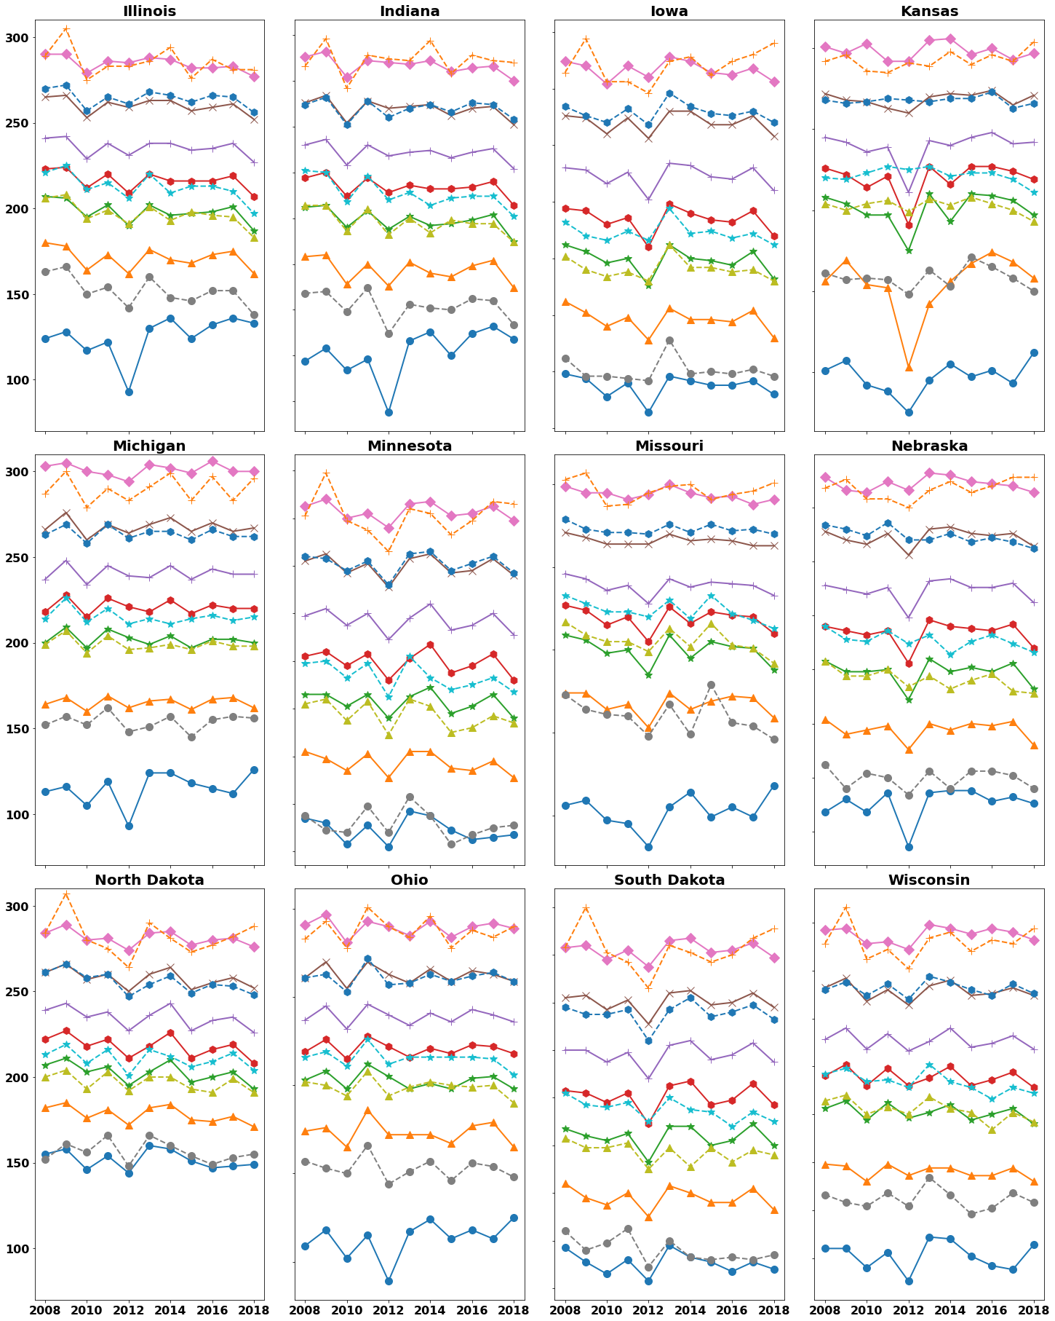
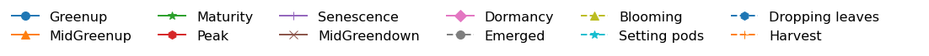
Day of year (DOY)
Year
Notes:
read_plot_phen_mat_func4.ipynb

Slide 11
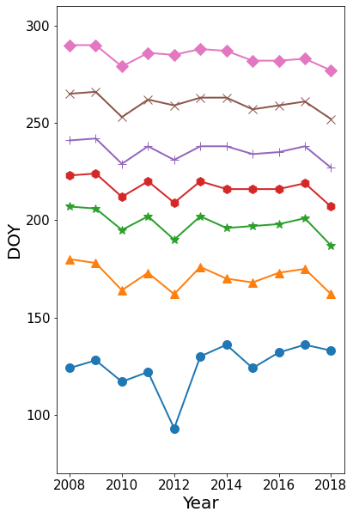

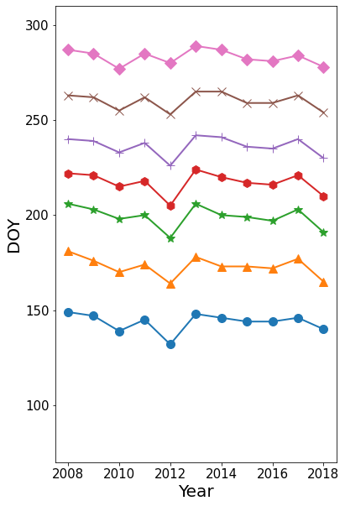
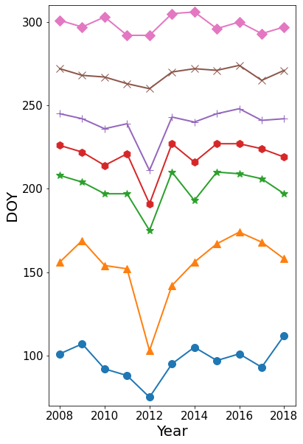

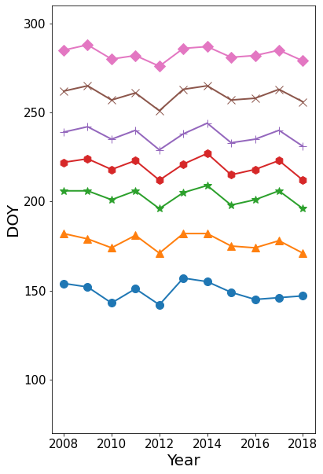
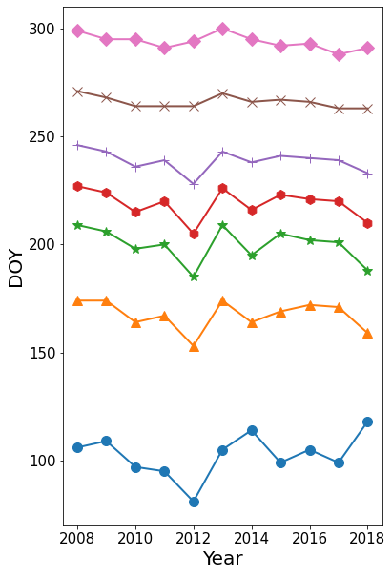
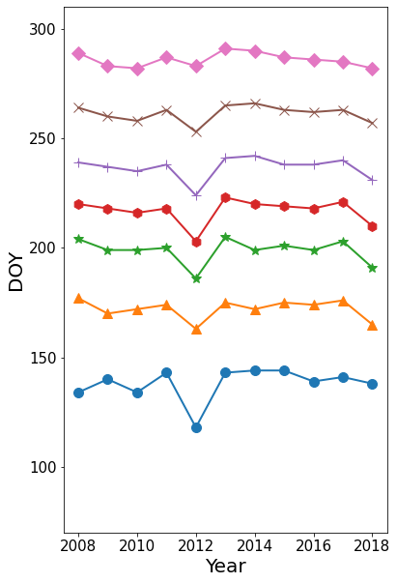
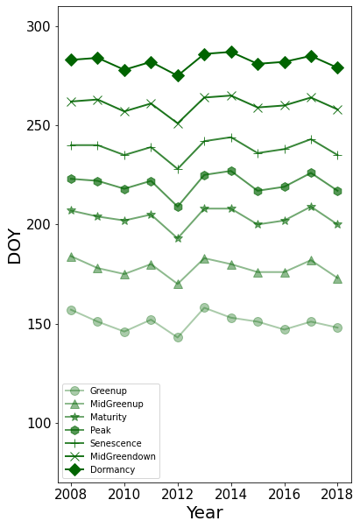


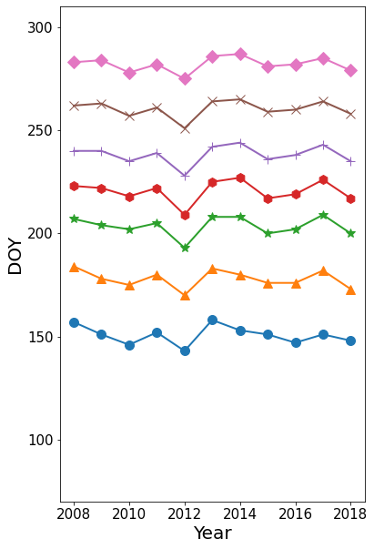
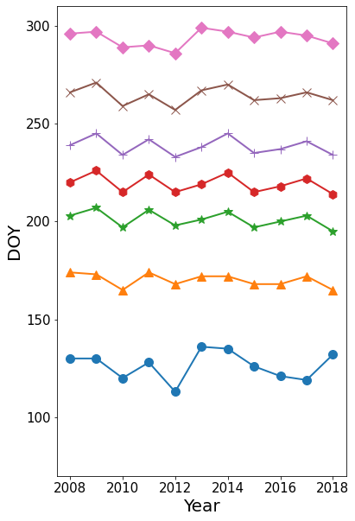
Notes:
Copy of read_plot_phen_mat_func.ipynb

Slide 12
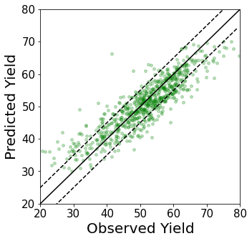
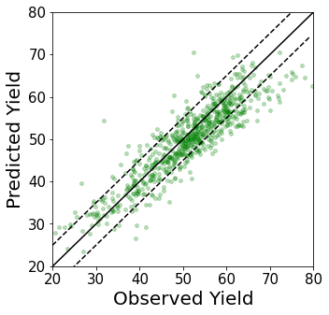
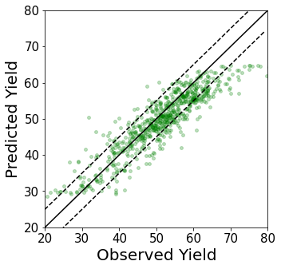
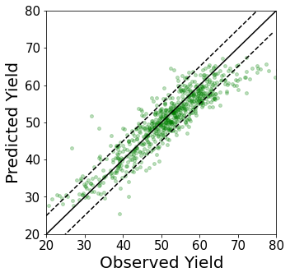
LSTM
SVR
RMSE=4.831
R²=0.646
Bias=-0.535
RMSE=4.721
R²=0.713
Bias=-1.372
RF
PB-CNN
RMSE=4.777
R²=0.667
Bias=-1.641
RMSE=4.350
R²=0.743
Bias=-0.928
Notes:
Copy of vpd_train_lstm_ann2.ipynb
Copy of new_train_lstm_ann.ipynb

Slide 13
LSTM
SVR
RMSE=4.831 bu/ac
R²=0.646
Bias=-0.535 bu/ac
RMSE=4.721 bu/ac
R²=0.713
Bias=-1.372 bu/ac
Predicted Yield (bu/ac)
RF
PB-CNN
RMSE=4.777 bu/ac
R²=0.667
Bias=-1.641 bu/ac
RMSE=4.350 bu/ac
R²=0.743
Bias=-0.928 bu/ac
Observed Yield (bu/ac)
Notes:
Copy of vpd_train_lstm_ann2.ipynb
Copy of new_train_lstm_ann.ipynb

Slide 14
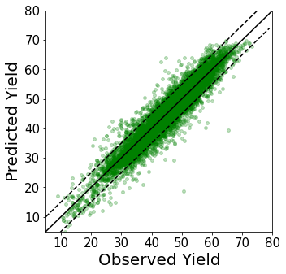
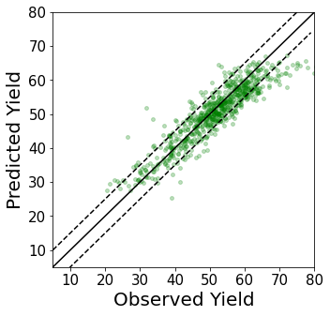
Training dataset
Testing dataset
Notes:
plot training samples.ipynb

Slide 15
Training dataset
Testing dataset
Predicted Yield (bu/ac)
Observed Yield (bu/ac)
Notes:
plot training samples.ipynb

Slide 16
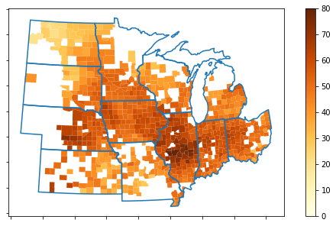
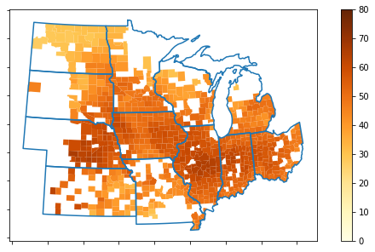
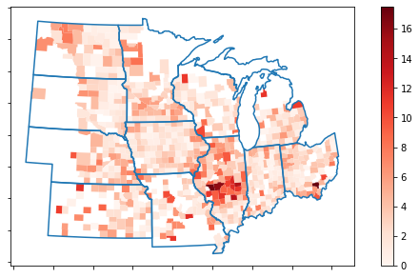
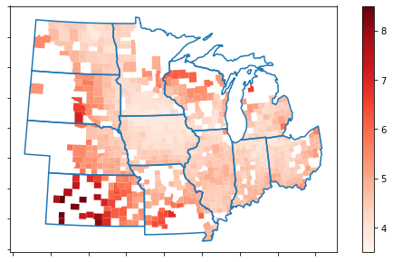

Observed Yield
Predicted Yield
a)
b)
RMSE
Total Predictive Uncertainty
c)
d)
e)
IL
IN
IA
KS
MI
MN
MO
NE
ND
OH
SD
WI
Notes:
GEOG_517_8_2.ipynb

Slide 17
Observed Yield
Predicted Yield
a)
b)
RMSE
Total Predictive Uncertainty
c)
d)
Notes:
GEOG_517_8_2.ipynb

Slide 18



Slide 19






Observed Yield (bu/ac)
a)
Predicted Yield (bu/ac)
b)
Absolute Error (bu/ac)
c)

Slide 20



Observed Yield (bu/ac)
a)
Predicted Yield (bu/ac)
b)
Absolute Error (bu/ac)
c)

Slide 21
Observed Yield (bu/ac)
a)
Predicted Yield (bu/ac)
b)
Absolute Error (bu/ac)
c)

Slide 22


Slide 23
(bu/ac)
(bu/ac)

Slide 24








[ 47, 69 , 71, 100, 28, 32]
[ 57, 26, 26, 100]
EVI2
Heat
Water
Soil
S1
S2
S3
S4
S5
S6
Notes:
plot_one_pheno_VPD.ipynb
Factors_new_train_VPD.ipynb
Variables_visual3.ipynb
train_best_model_permutation-importance

Slide 25

100
0
100
EVI2
Heat
Water
Soil
S1
S2
S3
S4
S5
S6

Slide 26
100
0
100
EVI2
Heat
Water
Soil
S1
S2
S3
S4
S5
S6

Slide 28

Total predictive uncertainty (bu/ac) in 2018

Slide 29


Aleatoric uncertainty (bu/ac) in 2018
Epistemic uncertainty (bu/ac) in 2018
Notes:
Plot_uncertainty_for2018.ipynb

Slide 30


Aleatoric uncertainty (bu/ac) in 2018
Epistemic uncertainty (bu/ac) in 2018
Notes:
Plot_uncertainty_for2018.ipynb

Slide 31


Aleatoric uncertainty (bu/ac) in 2018
Epistemic uncertainty (bu/ac) in 2018
Notes:
Plot_uncertainty_for2018.ipynb

Slide 32





a)
b)
Accuracy
P-factor
c)
IL
IN
IA
KS
MI
MN
MO
NE
ND
OH
SD
WI

Slide 33




a)
Yield (bu/ac)
NRMSE (%)
b)
Accuracy (bu/ac)
P-factor
c)

Slide 34

a)
Yield (bu/ac)
RMSE %
b)
Accuracy (bu/ac)
P-factor
c)
IL
IN
IA
KS
MI
MN
MO
NE
ND
OH
SD
WI

Slide 35





a)
b)
c)
Max Temperature
d)
e)
Precipitation
organic carbon content
IL
IN
IA
KS
MI
MN
MO
NE
ND
OH
SD
WI
IL
IN
IA
KS
MI
MN
MO
NE
ND
OH
SD
WI
Notes:
GEOG_517_8_6.ipynb
Copy of GEOG_517_6.ipynb

Slide 36


100
0
100
EVI2
Heat
EVI2
Water
Heat
Soil
S1
S2
S3
S4
S5
S6
Water
Soil
S1
S2
S3
S4
S5
S6

Slide 37
100
0
100
100
EVI2
Heat
0
100
EVI2
Water
Heat
Soil
S1
S2
S3
S4
S5
S6
Water
Soil
S1
S2
S3
S4
S5
S6

Slide 38
100
0
100
EVI2
Heat
Water
Soil
S1
S2
S3
S4
S5
S6

Slide 39

 | 2008 | 2009 | 2010 | 2011 | 2012 | 2013 | 2014 | 2015 | 2016
rmse | 4.379 | 4.59E+00 | 4.764 | 4.98E+00 | 4.539 | 4.67E+00 | 4.869 | 5.75E+00 | 5.731
T_Std | 4.749 | 4.32E+00 | 4.291 | 5.10E+00 | 4.867 | 5.47E+00 | 5.504 | 5.97E+00 | 6.119
D_Std | 3.869 | 3.65E+00 | 3.615 | 4.17E+00 | 3.865 | 4.37E+00 | 4.451 | 4.87E+00 | 5.036
M_Std | 2.715 | 2.28E+00 | 2.264 | 2.92E+00 | 2.937 | 3.28E+00 | 3.222 | 3.43E+00 | 3.443
Notes:
SA_plot.ipynb

Slide 40
Accuracy/Uncertainty (bu/ac)
Start Year
Notes:
SA_plot.ipynb

Slide 41





Slide 42




Slide 43





